Slide 1

BY-PRODUCT MATERIAL
is defined as radioactive material (except special nuclear material)
yielded in or made radioactive by exposure to the radiation incident
to the process of producing or using special nuclear material.
WHERE DOES IT COME FROM? | production or fabrication of fissile materials like plutonium.
WHAT DOES IT LOOK LIKE? | any radioactive material, except fissile nuclides, produced as waste during plutonium production or fabrication
Notes:
[1. BASAHIN SA SLIDE]: 'By-Product Material — comes from production or fabrication of fissile materials like plutonium.'
[2. SIMPLE IBIG SABIHIN]: Sa madaling salita po, ito yung mga tirang materyales na nahawaan ng radiation habang gumagawa ng plutonium.
[3. FOR EXAMPLE PO]: For example po, parang sa factory—yung plutonium ang main product na ginagawa nila, at yung mga tirang bakal o kemikal na nadikitan ng radiation habang ginagawa yun, yun po ang By-Product Material.

Slide 2
LOW-LEVEL WASTE (LLW)
includes everything not included in one of the other categories.
WHERE DOES IT COME FROM? | nuclear power plants, research reactors, test facilities, radioisotope manufacturers or users, uranium refining and conversion, and nuclear fuel fabrication
WHAT DOES IT LOOK LIKE? | used equipment, paper, cable, clothing, decommissioned parts, even mops
Notes:
[1. BASAHIN SA SLIDE]: 'Low-Level Waste — used equipment, paper, cable, clothing, even mops.'
[2. SIMPLE IBIG SABIHIN]: Ibig sabihin po, ito yung mga normal na gamit sa power plants at ospital na nadikitan lang ng konting radiation.
[3. FOR EXAMPLE PO]: For example po, pagkatapos maglinis o magtrabaho ng staff sa loob ng nuclear lab o ospital, yung ginamit nilang mop, pamunas, gloves, at suot na damit ay itatapon na bilang Low-Level Waste.

Slide 3

RADIOACTIVE WASTE MANAGEMENT
It refers to the safe treatment, storage, and disposal of liquid, solid,
and gas discharge from nuclear industry operations with the goal of
protecting people and the environment.
Notes:
[1. BASAHIN SA SLIDE]: 'Safe treatment, storage, and disposal of liquid, solid, and gas discharge.'
[2. SIMPLE IBIG SABIHIN]: Simple lang po ang goal nito: linisin at itago nang ligtas ang nuclear waste para protektahan ang tao at kalikasan.
[3. FOR EXAMPLE PO]: For example po, hindi pwedeng itapon lang sa ilog o sa normal na basurahan yung nagamit na tubig at usok mula sa nuclear plant—kailangan muna itong salain at i-seal nang maayos para walang magkasakit.

Slide 4
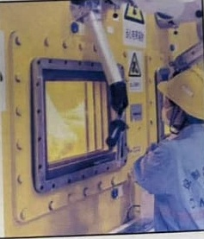
Most Radioactive Waste is
managed in the following ways:
• Planning & Preparation
• Waste Treatment
• Packaging
• Storage
• Disposal
Notes:
[1. BASAHIN SA SLIDE]: 'Planning & Preparation, Waste Treatment, Packaging, Storage, at Disposal.'
[2. SIMPLE IBIG SABIHIN]: Ito po yung step-by-step na proseso mula sa pagpaplano at pagpapaliit ng basura hanggang sa pagbaon nito.
[3. FOR EXAMPLE PO]: For example po, sa Packaging at Storage, nilalagyan nila ng semento yung bakal na drum—at gaya po ng nasa picture sa kanan, gumagamit yung worker ng remote mechanical arms sa likod ng makapal na yellow glass para hindi siya malapitan ng radiation.

Slide 5

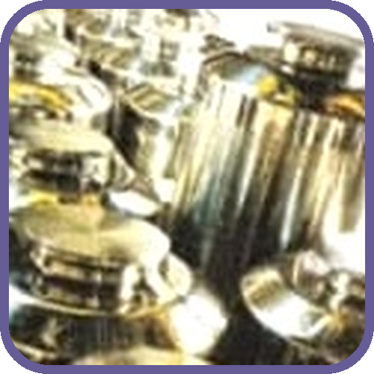
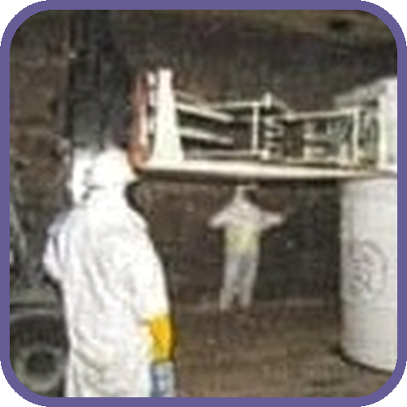
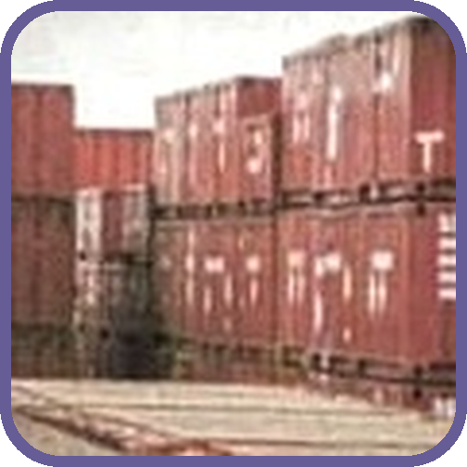
HOW SHOULD THIS RADIOACTIVE
WASTE BE MANAGED?
HIGH-LEVEL
RADIOACTIVE WASTE
TRANSURANIC WASTE
LOW-LEVEL
RADIOACTIVE WASTE
Notes:
[1. BASAHIN SA SLIDE]: 'High-Level, Transuranic, at Low-Level Radioactive Waste.'
[2. SIMPLE IBIG SABIHIN]: Depende po sa lakas ng radiation kung gaano kakapal ang lalagyan at kung gaano kalalim ito ibabaon.
[3. FOR EXAMPLE PO]: For example po, yung High-Level Waste sa unang picture ay nilalagay sa makapal na stainless-steel cylinder at ibinabaon nang malalim sa lupa, habang yung Low-Level Waste sa pangatlong picture ay sa pulang metal containers lang nilalagay.

Slide 6

NUCLEAR
WASTE DISPOSAL
Notes:
[1. BASAHIN SA SLIDE]: 'Nuclear Waste Disposal.'
[2. SIMPLE IBIG SABIHIN]: Ito naman po yung huling step kung saan permanente nang itinatago ang nuclear waste.
[3. FOR EXAMPLE PO]: For example po, imbes na itambak sa open dumpsite, gumagawa sila ng special vaults sa ilalim ng lupa—at makikita po natin ang porsyento nito sa susunod na slide.

Slide 7

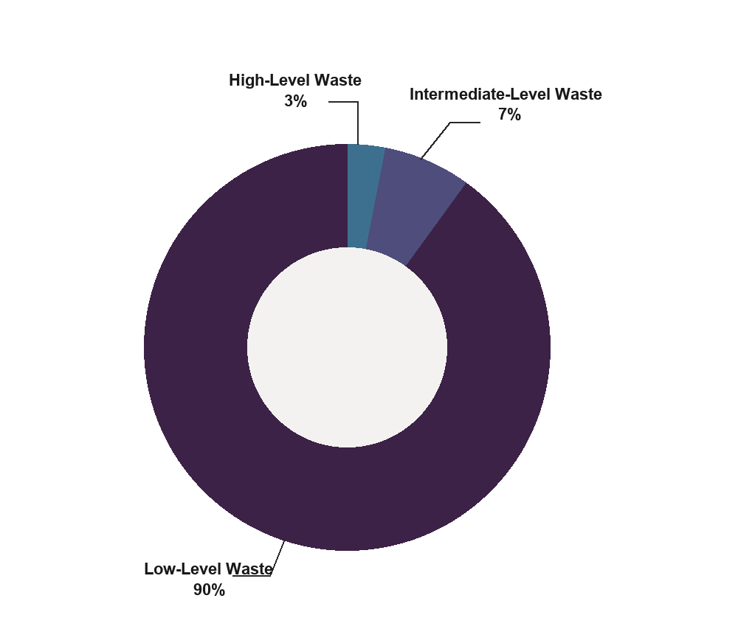
Like all industries and energy-producing technologies, the use of nuclear
energy results in some waste products.
High-Level Waste. Spent fuel, containing
95% of radioactivity in the nuclear waste.
Intermediate-Level Waste. Used filters,
steel components from within the reactor
and some effluents from reprocessing
containing 4% of radioactivity in the
nuclear waste.
Low-Level Waste. Lightly-contaminated
items like tools and work clothing
containing only 1% of radioactivity in the
nuclear waste.
Notes:
[1. BASAHIN SA SLIDE]: 'Low-Level ay 90% volume pero 1% radiation; High-Level ay 3% volume pero 95% radiation.'
[2. SIMPLE IBIG SABIHIN]: Ibig sabihin po, baligtad ang dami ng basura at lakas ng radiation niya.
[3. FOR EXAMPLE PO]: For example po, isipin natin na may 100 sako ng nuclear waste: yung 90 sako doon ay mga mop at gloves lang na may 1% radiation, habang 3 sako lang yung spent fuel—pero nandun sa 3 sako na yun ang 95% ng pinakamalakas na radiation!

Slide 8

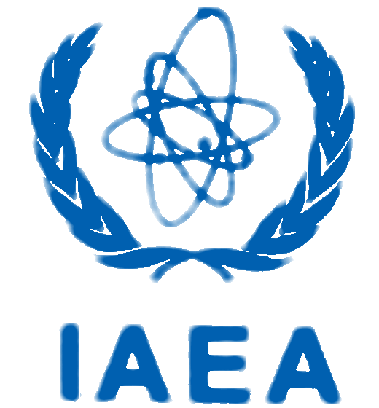
International Atomic Energy Agency (IAEA) is
an intergovernmental organization that
seeks to promote the peaceful use of nuclear
energy and to inhibit its use for any military
purpose, including nuclear weapons.
PNRI (Philippine Nuclear Research Institute) → National agency under DOST regulating safe nuclear & radioactive waste management in the Philippines.
Notes:
[1. BASAHIN SA SLIDE]: 'IAEA at PNRI (Philippine Nuclear Research Institute).'
[2. SIMPLE IBIG SABIHIN]: Yung IAEA po ang nagbabantay sa buong mundo, at yung PNRI under DOST naman po ang nagbabantay dito sa Pilipinas.
[3. FOR EXAMPLE PO]: For example po, kapag may ospital o laboratory dito sa Pilipinas na gumagamit ng radiation gaya sa cancer therapy o X-ray, ang PNRI po ang nag-i-inspect sa kanila, habang ang IAEA naman ang nagbabantay sa buong mundo para hindi ito gawing nuclear weapons. Maraming salamat po!

